Slide 1

Welcome
To
Our Presentation
“Artificial Intelligence and Expert System Lab”

Slide 2
Project On
Artificial Intelligence and Expert System Lab
Submitted By
Group No: 00
Subject Code: CSE 352
Intake: 29,30,31,32(Evening)
Section: 00
Department of CSE, BUBT
Supervised By
Name: Mr. Shamim Ahmed
Assistant Professor
Department of CSE, BUBT

Slide 3
Group Member Name
Group Member Name | Student ID | INTAKE
MD.Aminur Rhman | 18191203013 | 31
Shezan Mahmud | 17183203041 | 30
Anisur Rahaman | 17182203031 | 29
Md.Topu Raihan Robin | 18192203036 | 32

Slide 4
Project Name:
“Development of a Web Scraper to get news in one click”

Slide 5
Introduction
Web scraping typically extracts massive amounts of data from websites. This technology may directly access the World Wide Web using the Hypertext Transfer Protocol or a web browser. This is an automated process of gathering data in order to synchronize them for future usage. It is a form of extracting data and putting them in a local database so that further analysis and manipulation can be done on the data that was extracted from the websites.

Slide 6
Objective
The process of gathering information from different sources can be very time consuming and hectic if done manually. The development of a news scraper can fasten the process and save time.
The objectives of the project are:
To build a news scraper
To gather information in a more efficient way
To save time of searching different news sources
To present data in a more structured way

Slide 7
Tools and Technologies
Django
HTML
CSS
JavaScript
Beautiful Soup
SQLite (Database)

Slide 8
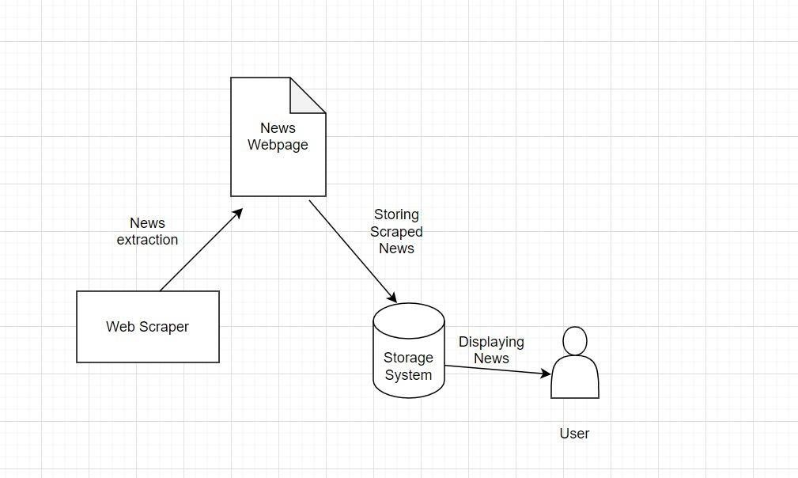
Diagram

Slide 9
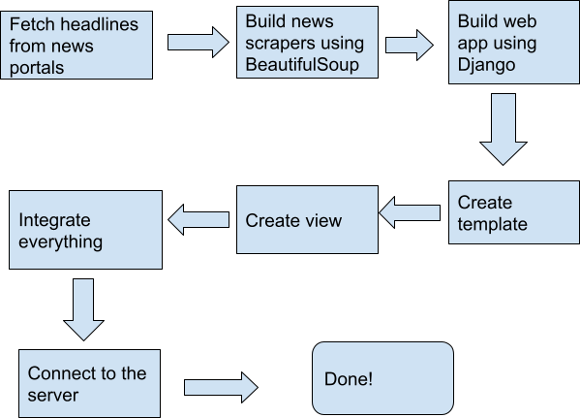
Steps of solving the problem
.

Slide 10
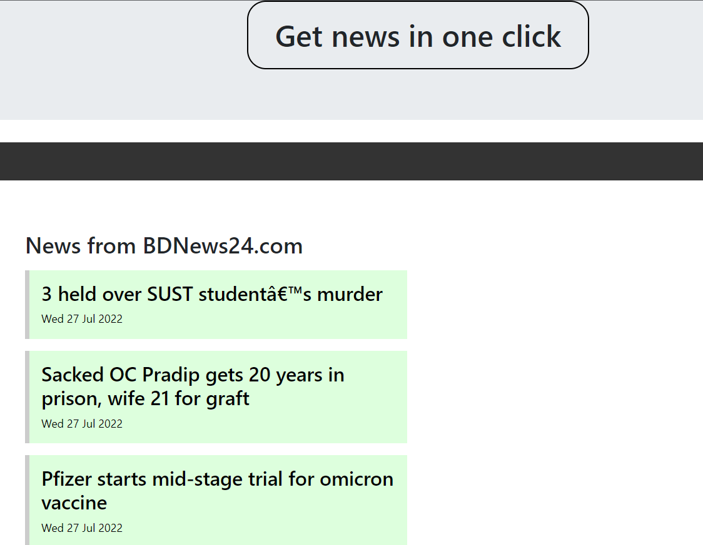
WEB UI Screenshot

Slide 11
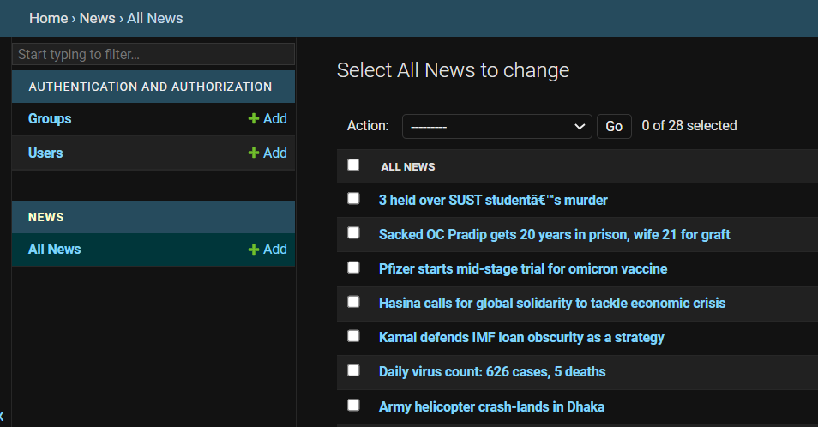
Admin UI Screenshot

Slide 12
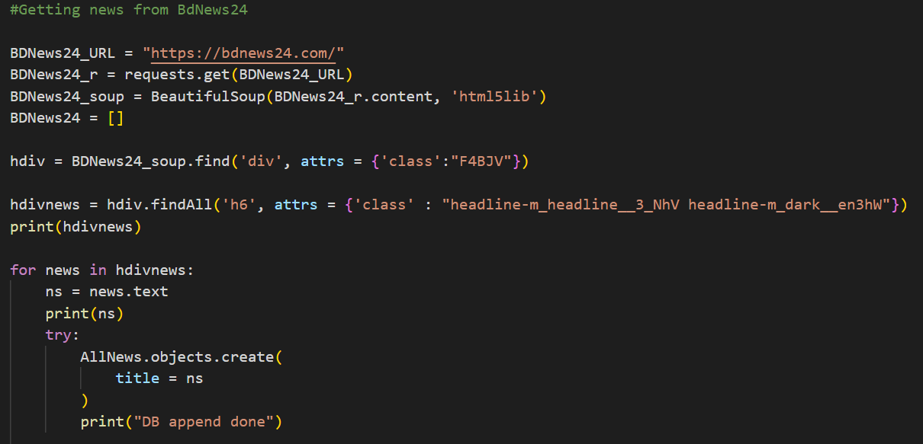
Functional Code Screenshot

Slide 13
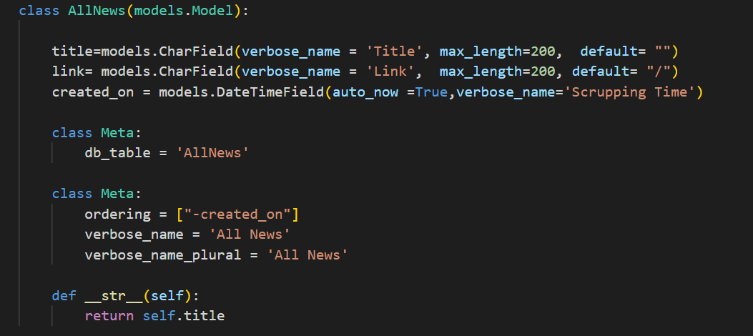
Database Model Code Screenshot

Slide 14
Limitations and Future scopes.
In this project have too many limitation. This is the first step of web scrapping.
In future we can develop or upgrade this project to a fake news detector and etc.

Slide 15
Conclusion
This project only provides an introduction to the practice of web scraping and highlights some of the tools available. Scrapy has many more features, be sure to refer to its full documentation for details.

Slide 16
HAVE ANY QUESTIONS SIR
?

Slide 17

Thank You For Watching…

